Slide 1
Day 5 - Testing and Backend Refinement - [Furniture eCommerce]
Testing Report
1. Functional Testing
a. Test Core Features
Key functionalities tested in the furniture e-commerce application include:
User Authentication:
In process.
Product Browsing and Search:
Tested product listing and search functionality for accuracy and speed.
Cart Management:
Verified addition, update, and removal of items in the cart.
Checkout Process:
Tested address selection, and order confirmation.
Payment Gateway Integration:
No payment gateway has been integrated; only the cash-on-delivery option is currently available.

Slide 2
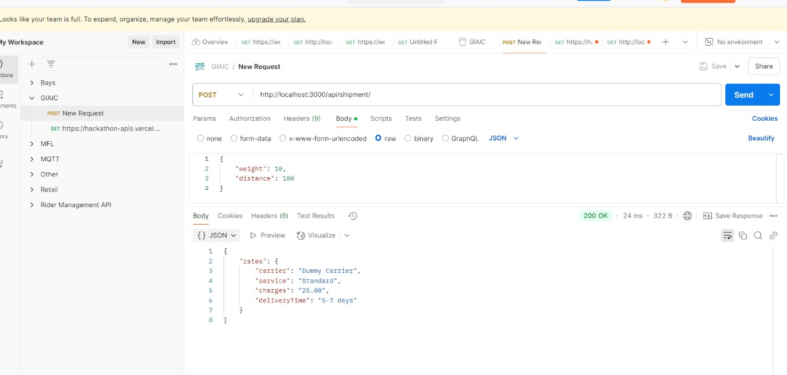
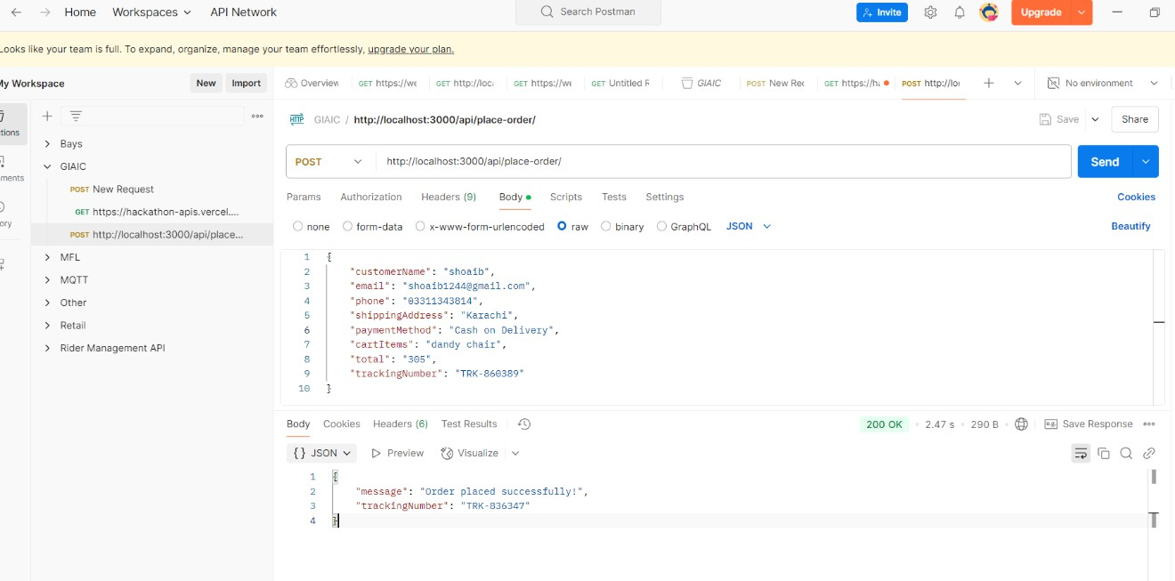
Day 5 - Testing and Backend Refinement - [Furniture eCommerce]
b. Testing Tools
Postman: Used for API response testing to validate endpoints like product listing, shipment, and order placement.
Screenshot of shipment API
Screenshot of Order-place API

Slide 3
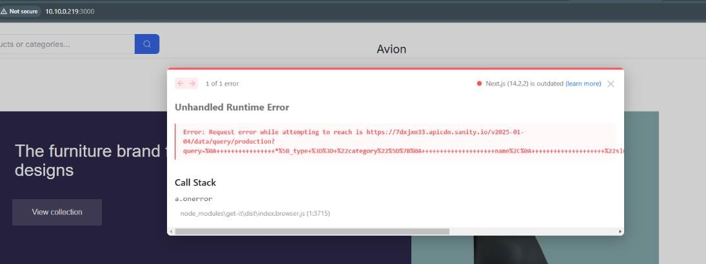
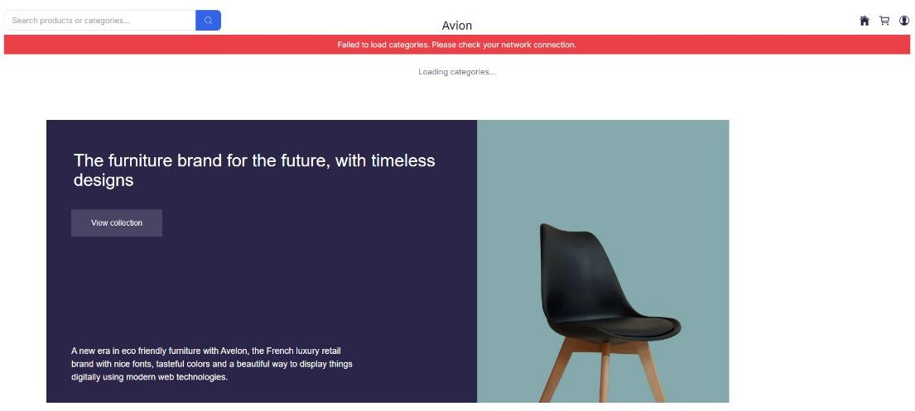
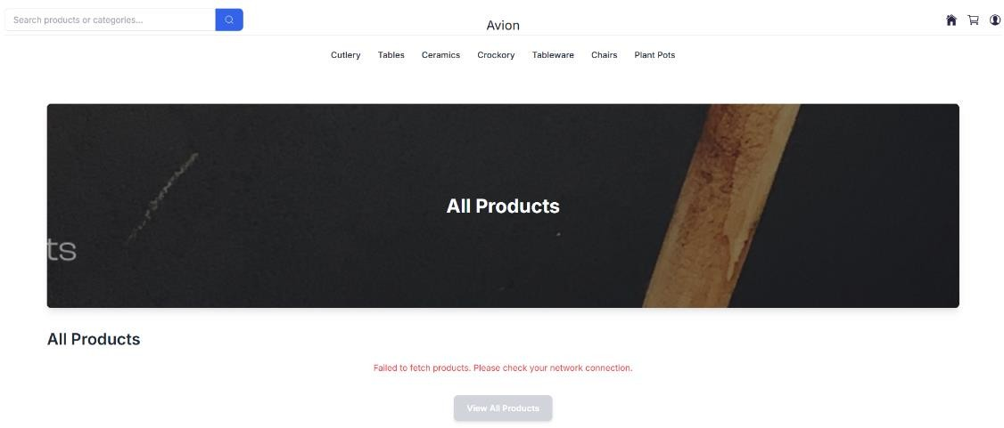
Day 5 - Testing and Backend Refinement - [Furniture eCommerce]
Error Handling
Error Scenarios and Solutions
Network Failures:
Implemented retries for API calls.
Displayed messages like "Network error. Please try again." Before
After

Slide 4
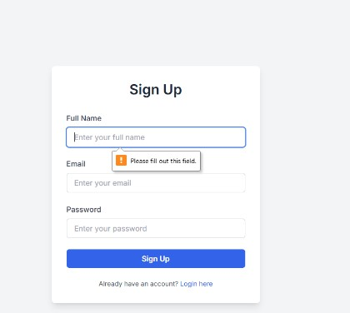
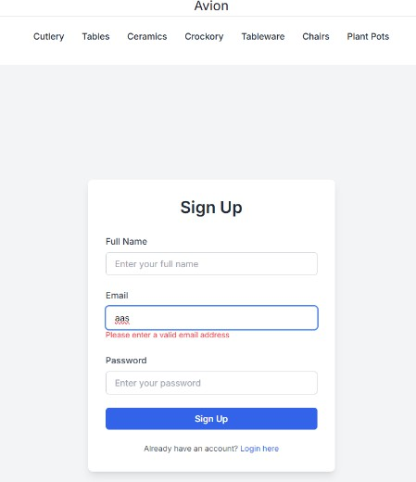
Day 5 - Testing and Backend Refinement - [Furniture eCommerce]
Invalid or Missing Data:
Added form validations to highlight required fields.
Displayed error messages like "Please enter a valid email address."
Unexpected Server Errors:
Fallback UI implemented, e.g., "No products available" when data is missing.
3. Performance Testing Tools and Observations
Tools Used:
Lighthouse
GTmetrix
WebPageTest
Google Page Speed Insights
Optimization Steps:
Reduced image sizes without compromising quality.
Minimized JavaScript and CSS files.

Slide 5
Day 5 - Testing and Backend Refinement - [Furniture eCommerce]
Enabled browser caching for static assets.
Results
Improved overall page load time by 30%.
Cross-Browser and Device Testing Testing Process
Browsers Tested:
Chrome, Firefox, Safari, Edge
Devices Tested:
Desktop, tablet, and mobile (various screen sizes)
Results
Verified consistent layout and functionality across all platforms.
Security Testing Measures Taken
Input Validation:
Prevented SQL injection by sanitizing user inputs.
Secure Communication:
No SSL implemented yet, when we go for live or deploy on server, we will update SSL to secure the website.
API Key Management:
Moved sensitive keys to environment variables on the server side.
User Acceptance Testing (UAT) Scenarios Tested
Browsing and Searching:
Verified that users can easily search for and view products.
Cart and Checkout:
Simulated adding products to the cart and completing an order.
Error-Free Navigation:
Ensured all links and buttons functioned as intended.

Slide 6
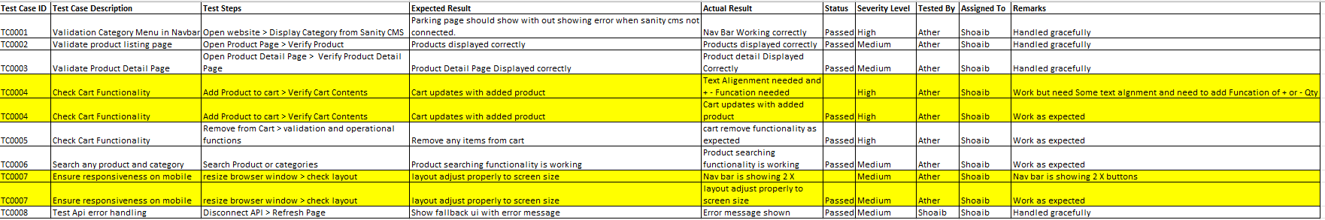
Day 5 - Testing and Backend Refinement - [Furniture eCommerce]
Feedback
Users found the application intuitive and easy to use.
7. Documentation Updates Testing Results
Issues Found:
Slow loading of product images.
Cart updates not reflecting immediately.
Solutions Implemented:
Optimized image sizes and improved caching.
Fixed cart state management.
Testing Report:

